Slide 1

Bench Conduct
& Demeanor for
Temporary Judges
Superior Court of California,
County of San Francisco
August 2021

Slide 2

INTRODUCTIONS

Slide 3
Presenters
Honorable Linda Colfax
  Dept. 20, Long Preliminary Hearings
Honorable Ethan P. Schulman
  Dept. 302, Law & Motion
Honorable Mary E. Wiss
  Dept. 305, Civil Trials

Slide 4
Why are you here?
To satisfy California Rules of Court
To ensure the public is well served - and believes it is well served
To learn about available resources
To be thanked

Slide 5
Program Materials
Rule of Court 2.4.1 Lawyer as Temporary Judge
Canon 6
Links to Ethics Resources
Settlement Conference Ethics
Selected Cases
MCLE Certificates
Evaluations

Slide 6
Objectives
Ethical rules
Communication
Fairness
Self-represented litigants (SRL’s)
Questions
Break at halftime
Notes:
Judge Flores

Slide 7
Goals
Ensure visible fairness, creating trust
Distinguish roles: attorney v. bench officer
Describe bench officer’s obligations
Sharpen issue-spotting skills
Make serving enjoyable and rewarding

Slide 8
Don’t Be Like...
“Judge Watson Video”

Slide 9
Questions
What did Judge Watson do wrong?
Did he express any legitimate concerns?
How could he have expressed them better?
How could he have avoided what occurred?

Slide 10
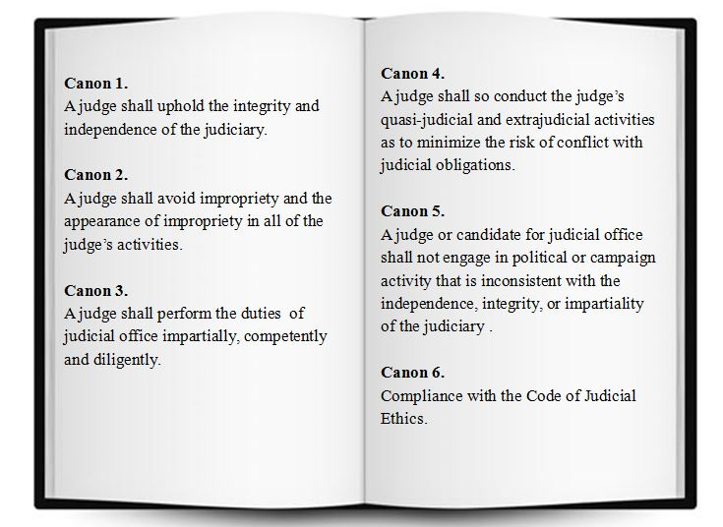
California Code Of Judicial Ethics

Slide 11
Canon 6
A “temporary judge…is a judge within the meaning of this Code. All judges shall comply with this Code except as provided below.”

Slide 12
Canon 6D
6D(1) - rules applying while presiding
6D(2) & (5) – rules specifically for pro tems
6D(6) – rule applying through final appeal
6D(7) – rule applying for 2 additional years
6D(8) & (9) - rules applying indefinitely

Slide 13
Canon 1
“… A judge should participate in establishing, maintaining, and enforcing high standards of conduct, and shall personally observe those standards so that the integrity and independence of the judiciary will be preserved….”

Slide 14
Canon 2A
“A judge shall respect and comply with the law and shall act at all times in a manner that promotes public confidence in the integrity and impartiality of the judiciary.”

Slide 15
Canon 3B(3)
“A judge shall require order and decorum in proceedings before the judge.”

Slide 16
Canon 3B(4)
“A judge shall be patient, dignified, and courteous to litigants, jurors, witnesses, lawyers, and others ….”

Slide 17
Canon 3B(8) - original text
“A judge shall dispose of all judicial matters fairly, promptly, and efficiently…

Slide 18
Canon 3B(8) – added text
  “…A judge shall manage the courtroom in a manner that provides all litigants the opportunity to have their matters fairly adjudicated in accordance with the law.”

Slide 19
Canon 3B(8)
(Commentary)
  “For example, when a litigant is self-represented, the judge has the discretion to take reasonable steps, appropriate under the circumstances and consistent with the law and the canons, to enable the litigant to be heard....”
Notes:
19

Slide 20
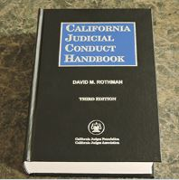
The California Judicial Conduct Handbook

Slide 21

The Central Principle of
Being a Judge
“The basic function of an independent, impartial, and honorable judiciary is to maintain the utmost impartiality in decision making.”

Slide 22
Pillar I-Awareness of Being a Judge
Always be aware that you represent the judiciary.

Slide 23
Pillar II-Mindfulness in Court
Be conscious of what you do and say in the courtroom. Always be attentive of what others are doing and saying in proceedings, and notice reactions, feelings, and thoughts in regard to what is taking place.

Slide 24
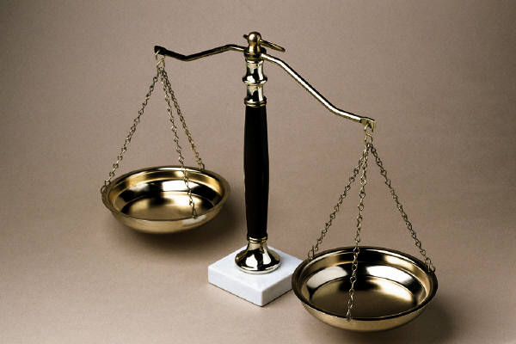
Pillar III-Rule of Law
Actions and decisions in court must be within the law.

Slide 25

Pillar IV-Do Not Make Assumptions
Challenge assumptions, and engage in no prejudging.

Slide 26
Pillar V-Professional Distance
Do not take things personally, either becoming embroiled or being an advocate.

Slide 27

Pillar VI-Honesty and Integrity
Ensure honesty and integrity in the process of making decisions and in the decision.

Slide 28

Pillar VII-Righteousness
& Courage
Do what is right according to law and work to have the courage to do so.

Slide 29
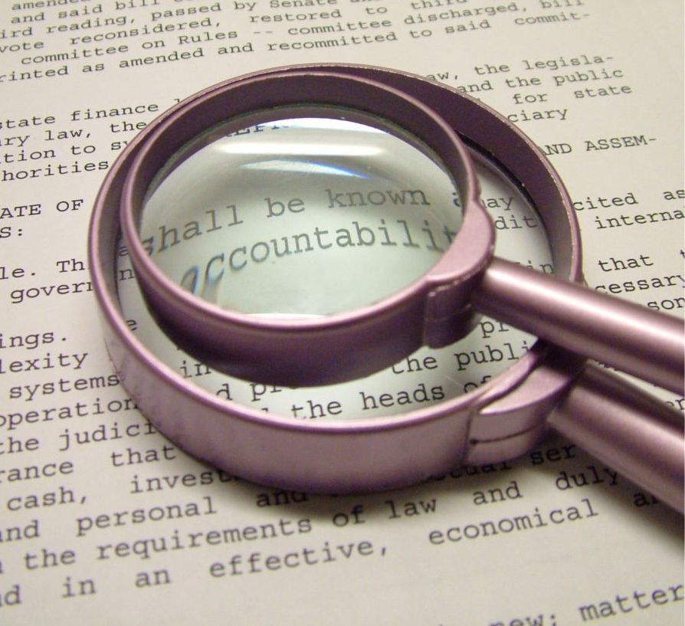
Pillar VIII-Accountability
Accept and ensure judicial accountability.

Slide 30
Triggers – In and Out of Court
We are subject to potentially annoying and even angering occurrences in court
They may be caused by things we are not aware of
Events from private life may increase our stress and affect our reactions

Slide 31
Self-Monitoring Test
Scale to determine individuals’ ability to self-monitor behavior and communication in various situations.
Go to: http://www2.courtinfo.ca.gov/protem/first/scale.htm

Slide 32

Communication

Slide 33
Don’t Be Like...
“Body Language Video”

Slide 34
Active Listening
Actually listen—acknowledge and focus on both speaker and message
Draw out the message
Communicate your understanding
Encourage confirmation or clarification

Slide 35
Body Language
Non-verbal cues
Energy
Open vs. closed communication
EQ & social intelligence

Slide 36





Break- 15 minutes

Slide 37
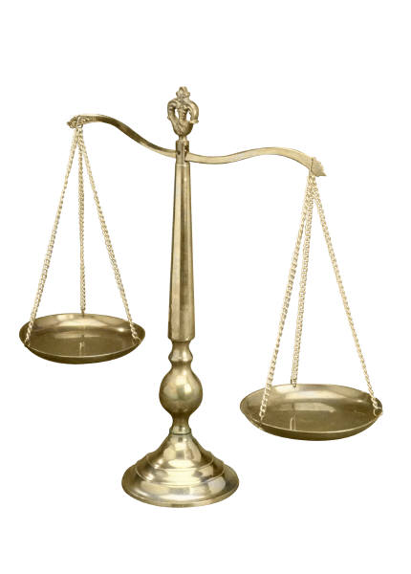
What is fairness?
Canon 3B 4, 8
Examples? Discuss
Notes:
Judge Dekreon

Slide 38
Fairness
impartiality and appearance of that
impropriety and appearance of that
(I know YOU are fair!)

Slide 39
Perception of fairness just as important as the reality
If people don't see you as fair, it doesn't matter what you intend

Slide 40
Procedural fairness
Feeling you have been heard
Perceiving the court as neutral
Feeling respected
Trusting the process

Slide 41
More important than winning:
Understanding the outcome—even if you don’t agree with it
Having day in court
    - Telling story
    - Being heard
Being treated with respect

Slide 42
Recognizing and Dealing with Bias

Slide 43
Canon 3B(5)
A judge shall perform judicial duties without bias or prejudice. A judge shall not, in performance of judicial duties, engage in speech, gestures, or other conduct that would reasonably be perceived as bias or prejudice, including but not limited to bias or prejudice based upon race, sex, gender, religion, national origin, ethnicity, disability, age, sexual orientation, marital status, socioeconomic status, or political affiliation, or sexual harassment.

Slide 44
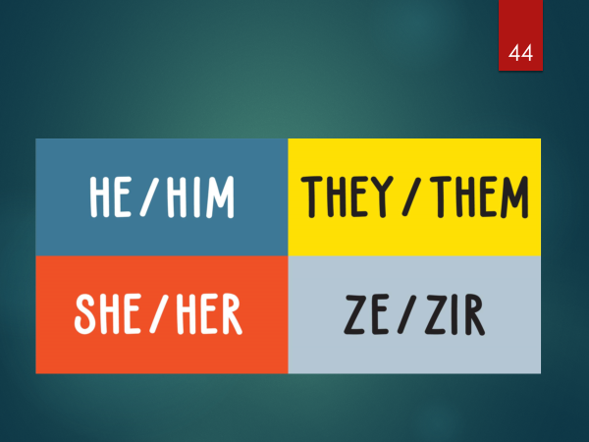
Gender Identity

Slide 45
Sensitive to cultural/ethnic/religious differences
Hats, headdress, clothing
Piercings/ hair
Looking in the eye /meeting gaze
Small English vocabulary
More/less circumspect and not addressing issue directly
Non verbal- what does a ‘smile’ really signify?

Slide 46

Whar Are My Biases?
Involves constant
re-examination

Slide 47
How bias is demonstrated
More abrupt responses to questions
Speech errors
Speech hesitations
Greater physical distance (pushing chair back)

Slide 48
How bias is demonstrated
More frequent blinking
Less smiling
Providing less time for speaking
Less open position

Slide 49
“WHODUNNIT Video ”
Notes:
Gorilla Video

Slide 50
Unconscious/Conscious Bias
Much of what we do is result of unconscious & unintentional thought
Looking –-and inevitably finding—data that confirms pre-conceived model of how the world is

Slide 51

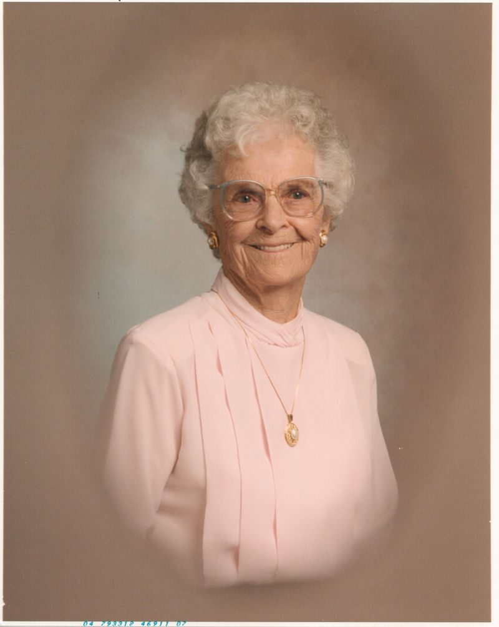
Reaction?

Slide 52
How To Avoid Bias
Be conscious. Mindful. Don’t allow reasoning mind to vaporize
Ask: Why am I here? What is my job?
Stay cool. Imagery (mountain, ocean)
Consciously confront your stereotypes

Slide 53
Miscellaneous
Internet Research (CJA) Judicial Ethics Committee Opinion no. 68)
Burdens of Proof
Standards of Review

Slide 54
Tips
Would I make same decision if ____ (fill in opposite- e.g., woman, White, fluent English-speaking, represented by counsel, etc.)
What are my buttons, and how do people push them?
Model the behavior you’re looking for
Watch yourself

Slide 55
Tip
“I can live with doubt and uncertainty and not knowing. … If we will only allow that … we will leave opportunities for alternatives. … In order to make progress, one must leave the door to the unknown ajar.”
― Richard P. Feynman

Slide 56
Top Tip
“The greatest of faults … is to be aware of none.”
- Thomas Carlyle

Slide 57
Self-Represented Litigants
Notes:
Judge Murphy

Slide 58
Don’t Be Like…
“Self Represented Litigants Video ”
Notes:
Video “Self Represented Litigants “ – Marjorie Slabach

Slide 59

Fairness to SRL’s
Required: recall Canon 3B(8)
Language, literacy, mental and emotional obstacles may exist
SRL’s may need more help
But fairness $≠$ giving legal advice

Slide 60
Suggestions With SRL’s –
Level 1
Manage your calendar
Tell them the procedures up front
Acknowledge obstacles
Let them get their case out
Monitor comprehension
Avoid jargon

Slide 61
Jargon SRL’s May Not Get
Plaintiff/Defendant
Petitioner/ Respondent
Pro per
Submitted
Admissible/ Inadmissible
Sustained/ Overruled
Cross examination
Rebuttal
Pleading

Slide 62
Level 2
Control repetitive testimony
  Show you already got the point
  Direct them to the next issue
Directing an unfocused SRL
  “Help me understand …”
  “Tell me more about …”
  “Do you have the bills [or other docs] for …”

Slide 63
Level 3
Monitor interruptions
Do not tolerate abusive language
Consider hand-gesture hierarchy
Use breaks
Bailiffs

Slide 64
But - Avoid Intimidation
Ignoring
Impatience
Looking angry
Giving orders (“Sit down. Now.”)
Using needless jargon

Slide 65
Don’t be like…
“Tales of Woe Video”

Slide 66
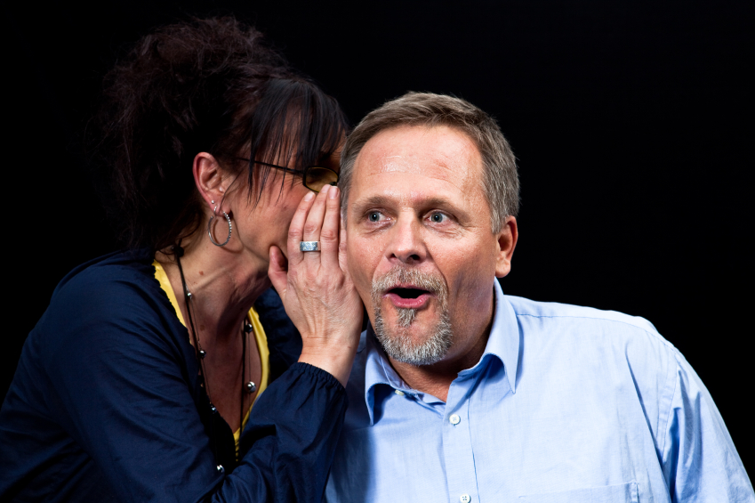
Ex Parte communications

Slide 67
Ex Parte Restrictions
Canon 3B(7) – limits ex parte communication
  (applies until termination)
Canon 6D(6) – no public comment
  (applies through final appeal)
Canon 6D8(a) – nonpublic information
  (applies indefinitely)

Slide 68

Access: ADA
Request for Accommodations By Persons w/ Disabilities
California Rule of Court 1.100
Providing Accommodations while Court is in session
MC 410 Form

Slide 69
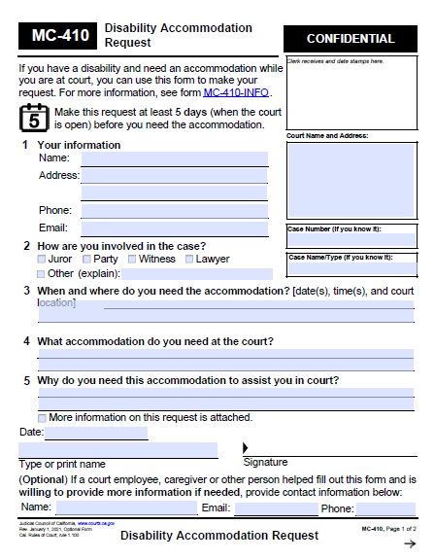
MC410 Form - Response

Slide 70
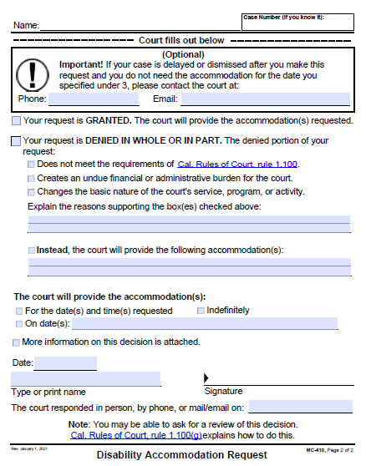
MC410 Form - Response

Slide 71

Thank you!

